Slide 1
Managerial Economics and
Organizational Architecture Chapter 12: Decision Rights:
The Level of Empowerment

Slide 2
Assigning Tasks and Decision Rights
UBS & Bank of America; Centralization -> Decentralization (groups/team) -> Centralization…
Fiat
General Electric
Motorola
Google
Apple…….
Production processes involves tasks (delopgaver) bundled into jobs
Job dimensions
variety of tasks
few or many?
decision authority (on the tasks to be completed)
limited or broad?
2

Slide 3
Dimensions of Job Design
Kap. 13
(ikke pensum)
Many
2
4
Sekretær
Generalist
Variety of tasks
’Skriver’
Sælger
1
3
Few
Kap. 12
Decision authority/autonomy
Narrow
Broad
3

Slide 4
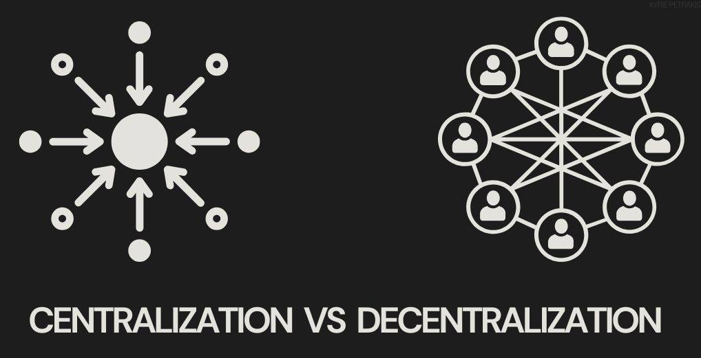
Centralization vs Decentralization
Automart example
AutoMart sells automobiles in two cities
Hierarchy includes CEO and two local managers
Which decisions are to be retained by the CEO (centralization)
Which decisions should be delegated to local managers (decentralization)?
4 possibilities:
This choice determines on which level of the firms’ hierarchy to place the decision right!
Ex. fig. 12.2; who should determine prices?
Roberto (Bob) (cent.)?
Dec.; Pekka Colleen?
Dec.; Colleen Pekka?
Dec.; Team – Pekka/Colleen?
Kilde: https://www.shiksha.com/online-courses/articles/difference-between-centralization-and-decentralization/
4

Slide 5
Benefits of Decentralization
Effective use of local knowledge
local tastes and preferences
price sensitivities of particular customers
Conservation of management time
opportunity costs for managers
senior management (should/can) focus on strategy
Training and motivation for local managers
5

Slide 6
Costs of Decentralization
Potential agency problems!!
Effective control systems may be expensive –
Coordination costs and failures
Interaction effects can be ignored
Duplication and cannibalization may occur (ex. in markets)
Less effective use of central information
Product costs, promoting information flows and coordination among decentralized decision makers..
Forgone scale economics
Economies of scale needs coordination
Vigtigt - ramme 382ø.
6

Slide 7
Determining the Level of Decentralization (1) – The Firms Choice
D is the degree of decentralization
If D = 0, all pricing decisions are made by Bob
B, A and C are positive constants
Benefits of decentralization = B×D
Costs of decentralization =(A×D)+(C×D²)
Where AD represents contracting costs
CD represents coordination/information costs (se og ramme note 8!)
7

Slide 8
Determining the Level of Decentralization (2)
Objective: maximize net benefits
NB = BD - AD - CD²
…..which occurs when
D* = (B-A)/2C
(which require a bit - but just at bit - of calculus)
Helt straight – se note 9! Rødder, lokale min./max.
Lidt mere kompliceret, hvis mere end én beslutnings-rettighed skal allokeres.
Ramme p. 385-386m.
8

Slide 9
Determining the Level of Decentralization (3)
$
Costs
Benefits
Total costs and benefits (in dollars)
D
9
D*
Decentralization

Slide 10
Determining the Level of Decentralization (4)
Over time, the costs and benefits will change
Information costs and incentive costs may fall as technologies change
Benefits may increase if the importance of local knowledge increases
10

Slide 11
Management Implications
The net benefits of decentralization will be highest in rapidly changing environments
Benefits of decentralization increases as a firm enters more markets with a broader array of products
Local/specific knowledge/information become more important
11

Slide 12

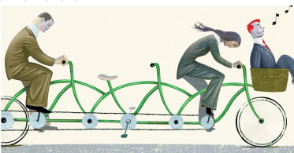
Benefits and Costs of Team Decision Making
Benefits of team decision making
improved use of dispersed specific knowledge
employee buy-in (p. 391); idéen om commitment!
Costs of team decision making
collective-action problems (slow speed, 392ø.; “a camel is a horse designed by a committee”)
free-rider problems
Kilde: https://intellisoft.io/team-based-organizational-structure-to-optimize-your-teams-output/
Kilde: https://plutuseducation.com/blog/free-rider-economics/
12

Slide 13
Management Implications of Team Decision Making
Team decisions are more beneficial when
Specific knowledge is dispersed
It is easy to control
a) the costs of collective decision making and
b) the free-rider problem
Optimal team size
Consider the trade-off between the increased knowledge base and the costs of team decision making
13

Slide 14

Decision Management and Control (1) (meget centralt begrebspar med udtalt relevans også for VØS (5))
Decision management is the initiation and implementation of decisions
Decision control is the ratifying and monitoring of decisions
Kilde: https://www.profit.co/blog/behavioral-economics/understanding-decision-making-in-organizational-strategy-and-management/
14

Slide 15
Decision Management and Control (2)
Four steps occur (chronologically):
Initiation
Generation of proposals for resources utilization and structuring of contracts
Ratification
Choice of decision initiatives to be implemented
Implementation
Monitoring
Ramme p. 394 – 395!
15

Slide 16
Decision Management and Control (3)
Basic principle/’rule of thumb’:
If decision makers do not bear the major wealth effects of their decisions - if they are neither owners, nor residual claimants - decision management and decision control should be held by separate decision makers!!!
Eksternaliteter!
The Controllability Principle:
’Holding managers (and other agents, TV) responsible for only those decisions for which they are given authority ((decision rights) … ‘and therefor can control’, TV)’.
(Zimmerman. J. (2020), p. 654: Accounting for Decision Making and Control)
Def.: “Residual claimant; the person with the legal right to the profits of the enterprise once all the other clai-mants of the firm (ex. bond-holders, employees) are paid”! (p. 394n).
16

Slide 17

Decision Management and Control (4)
Both ideas explain why boards of directors have the ‘ability’ to ratify decisions made by CEOs
Boards also have monitoring authority
Monitoring authority is also held by large shareholders
Kilde: https://boardmember.com/5-reasons-your-board-doesnt-need-an-ai-specialist/
17

Slide 18

Influence Costs – the possibility of lobbying
Employees have incentives to influence managerial decisions
Influence activities may entail costs
time away from the job
dysfunctional activities
Limits on managerial discretion may reduce influence costs (obj./subj. performance evaluation)
When firm’s profits are unaffected by decisions that may have a major impact on individual employees, ‘bureaucratic rules’ are more likely – se Unites Airlines eksemplet (Hawaii, seniority)!
Kilde: https://saisobserver.org/2018/10/03/government-lobbying-in-the-us-and-eu/
18

